Slide 1

medical appointment no shows dataset MSDS 670 Midterm Courtney Drysdale July 27, 2025

Slide 2

Table of contents
Dataset information
Research Question
Methodology
Visualizations
Results
Conclusion

Slide 3

Dataset
This dataset is made up of 110,527 medical appointments in a city in Brazil over a few months in 2016. It has 14 variables, which include demographic information (gender and age), dates (date scheduled and date of appointment), medical details (certain conditions), and whether or not the patient no showed. I cleaned the data and created new variables based on the provided variables (day of the week, days between scheduling and appointment date).

Slide 4

RESEARCH QUESTION
Which groups of people are more likely to no show a medical appointment?

Slide 5

METHODOLOGY
Looking at overall demographics/attributes of the patient group
Looking at differences between the "no show" group and patients who attended appointments
Identify groups at higher risk of "no showing"
Summarize dataset for medical group

Slide 6
Overall no show counts
Out of 110,527 appointments, 22,319 patients no showed, while 88, 208 attended their appointment.
Going forward, I will break my analysis into comparing no shows and those who attended their appointments. I used pivot tables in Excel to get the information organized to make these charts.

Slide 7
No shows by gender
When looking at the numbers, it appears that there are twice as many female patients who no showed as male patients. However, there are also about twice as many female patients in the dataset, so when we look at it proportionally, it is about the same amount of male and female patients who no show.
Notes:
When looking at the numbers, it
appears that there are twice as many
female patients who no showed as
male patients. However, there are
also about twice as many female
patients in the dataset, so when we
look at it proportionally, it is about
the same amount of male and female
patients who no show.

Slide 8
No shows by scholarship
Being "on scholarship" in Brazil is the way they refer to government assistance for healthcare. While there are much fewer people on scholarship in the dataset, there are slightly more proportionally in this group to no show an appointment.

Slide 9
No shows by day of week
No Shows happen every day of the week but happen more often earlier in the week. This dataset also had data for a few Saturday appointments (39) but there were so few no shows (9) that I left it off the chart.

Slide 10
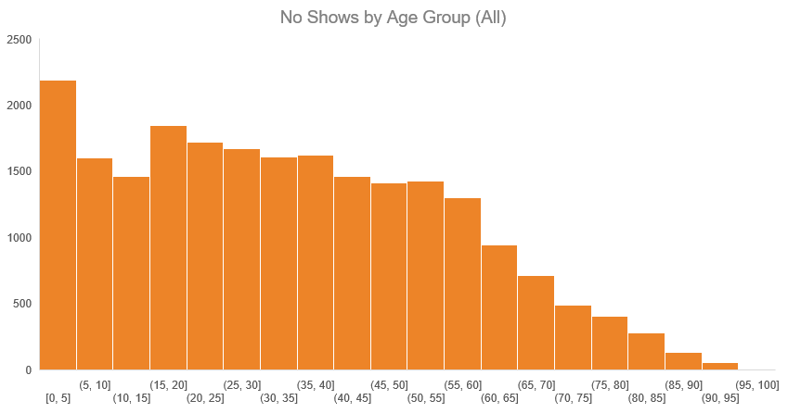
No shows by age group
First I looked at the no shows on a histogram for all ages in 5 year bins. I noticed that there were more no shows toward the younger ages, so next I looked at no shows just among children.

Slide 11
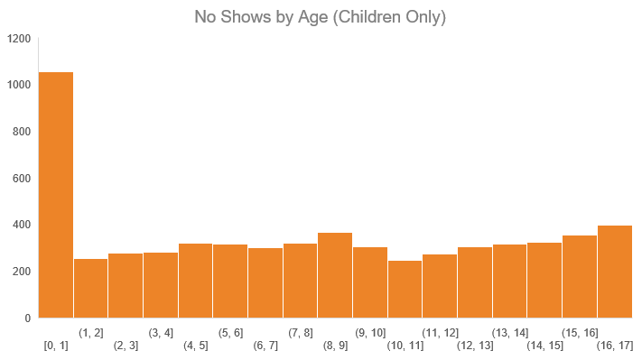
No shows by age group (Children only)
When I made this chart for no shows among children, there were overwhelmingly more no shows for children under age 1 than any other group.

Slide 12
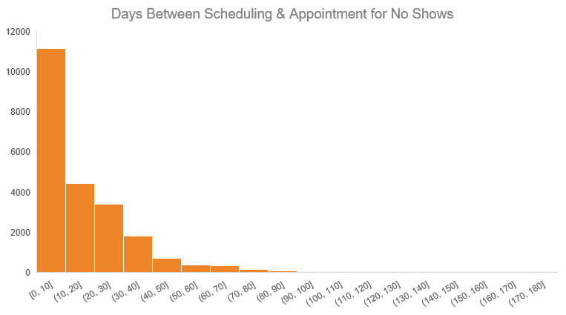
No shows by Number of days between scheduling & appointment
Finally, I looked at the number of days between scheduling the appointment and the actual appointment. Nearly half of the no shows were appointments that had been scheduled within the next 10 days.

Slide 13
conclusions
The age group at most risk of no showing are children under age 1.
Male and female patients no show at about the same rate.
Patients on scholarship no showed at a slightly higher rate than those not on scholarship.
More patients no showed earlier in the week.
More patients no showed to appointments they had scheduled within 10 days.

Slide 14

Thank you

